Slide 1
Pet Adoption
Submitted By: Submitted To:
Sahil (2110991217) Mr. Ashwani Dubey
Sahil Gupta (2110991222)
Bhumi Gurung (2110991957)
Shreya Banta(2110992008)
Department of Computer Science and Engineering
Chitkara University, Punjab

Slide 2
PROBLEM STATEMENT
The field of animal care and welfare faces various challenges in effectively connecting animal lovers, animal care centres, and individuals seeking assistance. Existing solutions often lack a centralized platform that provides comprehensive information about animals in need, streamlines the adoption process, and facilitates the donation of animals. These limitations hinder the efficiency and effectiveness of efforts aimed at promoting animal welfare.
The project seeks to develop a solution that not only offers a centralized repository of animals in need but also streamlines the adoption process and facilitates efficient animal donations. Through user-friendly interfaces, personalized user logs, and effective communication channels, Pawfect Connect aims to enhance the user experience and create a vibrant community of animal enthusiasts actively contributing to animal welfare.
Finally, the Pawfect Connect programme aims to address the problems of a lack of efficient methods for animal donation, a lack of organised data, and inefficient adoption procedures. The objective of the project is to build a comprehensive web application that will act as a hub for introducing users to animals in need, easing the adoption process, and facilitating efficient animal donations.

Slide 3
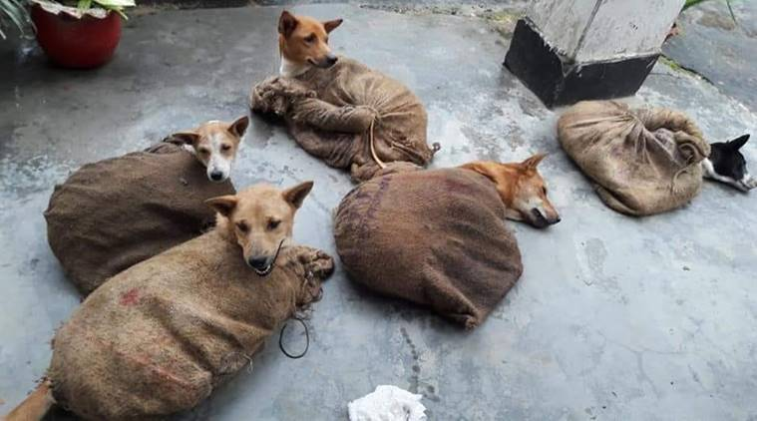
Objective and need of the project:
To provide a website application that enables customers to browse animals available for adoption, send adoption ,forms, and schedule meet-and-greet times.
To create an administrative panel for animal rescue organizations
to manage animal profiles, adoption applications, and event schedules.
To integrate a payment gateway and donation system to support the animal
rescue organization's funding needs.

Slide 4
Continued…
The prevention of the spread of diseases and germs can be aided by saving and treating animals when they are sick and in need of care.
To implement a messaging system that allows adopters to communicate with animal rescue organizations directly.
If someone wants to join the NGO, they can apply using the form that will be available on our website.

Slide 5
Requirements and Technologies used in The project:
The project can be executed by developing a web application that allows users to browse animals available for adoption, submit adoption applications, and schedule appointments. The web application can also include an administrative panel for animal rescue organizations to manage animal profiles, adoption applications, and event schedules.
Technologies used in this project:
For Frontend : React.js , Materialize CSS
For Backend : MongoDb and express
Version Control: A version control system such as Git may be required to manage code changes and collaborations.

Slide 6
Outline of the website
The website consists of 3 main pages:
Main Page:
There are 2 main parts on the main page.
First of all there is a beautiful and interactive logo of our website on the top.
The header in the first section has icons and links that can be used to browse the entire website and link to other pages where we have stored information about different animals.
In order to grow our group and raise awareness, our website link will also be in the footer.

Slide 7
Second Page:
This page has a header and a footer, just like the primary website. Also it will have the section that will tell the all the information about the animals which are need o be adopted like their breed,color,age etc..
The page will have an intractive ui/ux style that users will find appealing. Additionally, the website will be responsive, meaning that it will alter its size in accordance with the screen's dimensions.
Third Page:
The third tab contains a contact form that allows users to engage with the website and is used to submit website-related questions.
Additionally, the document will be properly validated.

Slide 8
About Front- End
Our animal helpline and adoption center website is a platform designed to help people connect with animals that are available for adoption. The website’s Front-end serves as a central hub where visitors can learn more about your organization, browse profiles of animals that are available for adoption, and take steps to adopt a pet.
We started our project by using front-end, we mainly focused on creating a user-friendly and visually appealing design that is easy to navigate. Here are some key elements to consider, which are listed in the next few slides.

Slide 9
Continued…
Navigation: Our website have clear navigation that is easy to find and user. This include a menu bar or navigation panel that allows visitors to quickly find the information they are looking for.
Homepage: Our homepage provide an overview of our organization and the services we provide. This include information about the animals that are available for adoption, upcoming events, and ways to get involved.

Slide 10
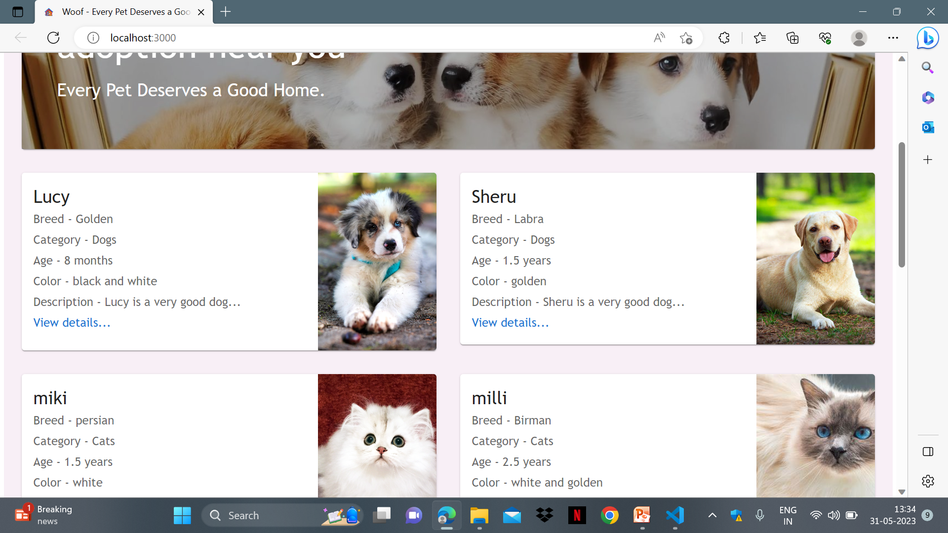

Slide 11
Continued…
Animal Profiles: Each animal available for adoption have its own profile page that includes photos, a description of the animal's personality and history, and any other relevant information.
Contact Information: You should prominently display your contact information on your website, including your phone number, email address, and physical address.

Slide 12
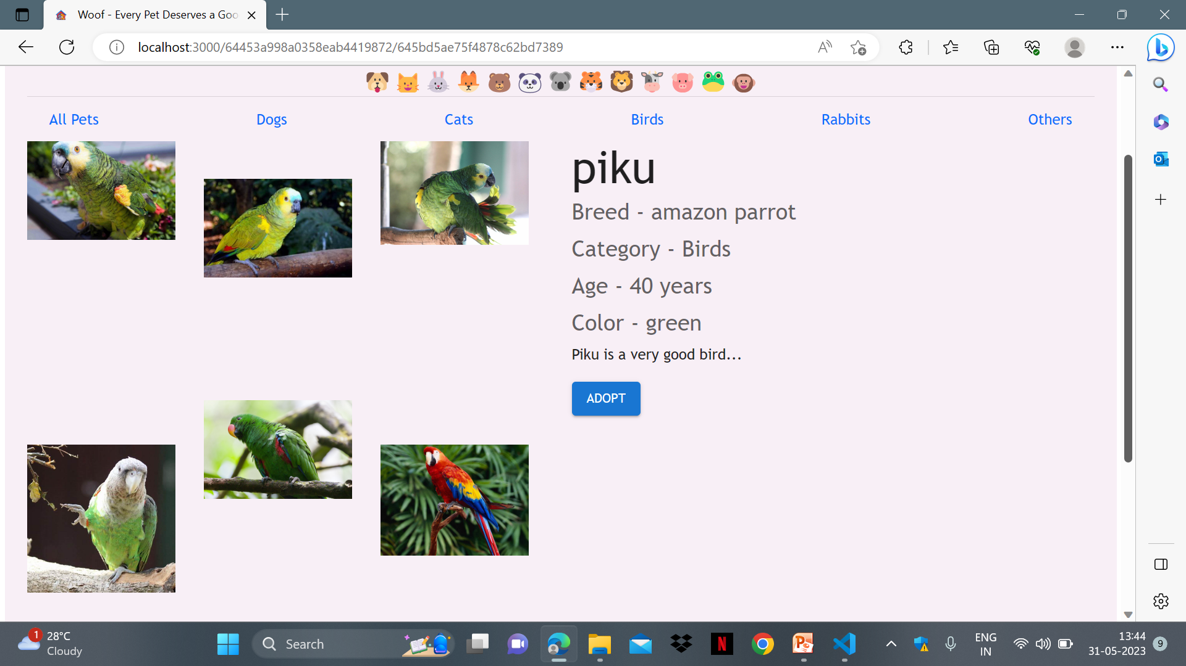

Slide 13
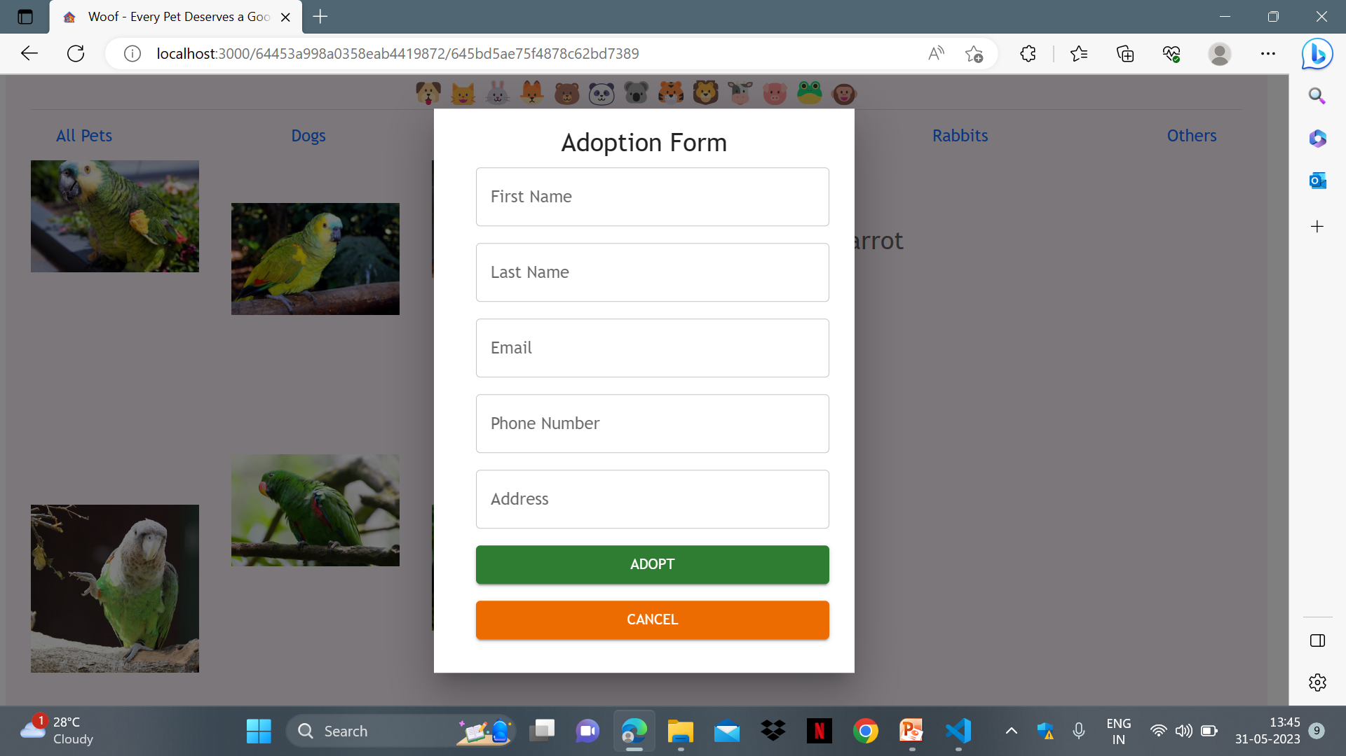
Continued….
Adoption Application: We provided an easy-to-use adoption application form that allows potential adopters to apply for the animal they are interested in.

Slide 14
About Back-End
The back end of our website is responsible for managing the data and functionality that powers the front end. This includes tasks such as storing and retrieving data, managing user authentication and authorization, and handling business logic and workflows.
For the connection of our front end with back end ,we mainly used MongoDB.
With MongoDB, we can store and manage data for animal profiles, adoption applications, user profiles, events, donations, and more. MongoDB provides a flexible, scalable, and robust database solution that can support the back-end functionality of our website, making it easier to manage and analyze data and provide a seamless user experience for our visitors.

Slide 15
Continued…
Animal Profiles: Each animal that is available for adoption on our website is represented by a document in our MongoDB database. The document include fields for the animal's name, age, breed, personality traits, medical history, and any other relevant information
User Profiles: If you allow visitors to create user profiles on your website, you can use MongoDB to store user data such as usernames, passwords, and contact information.

Slide 16
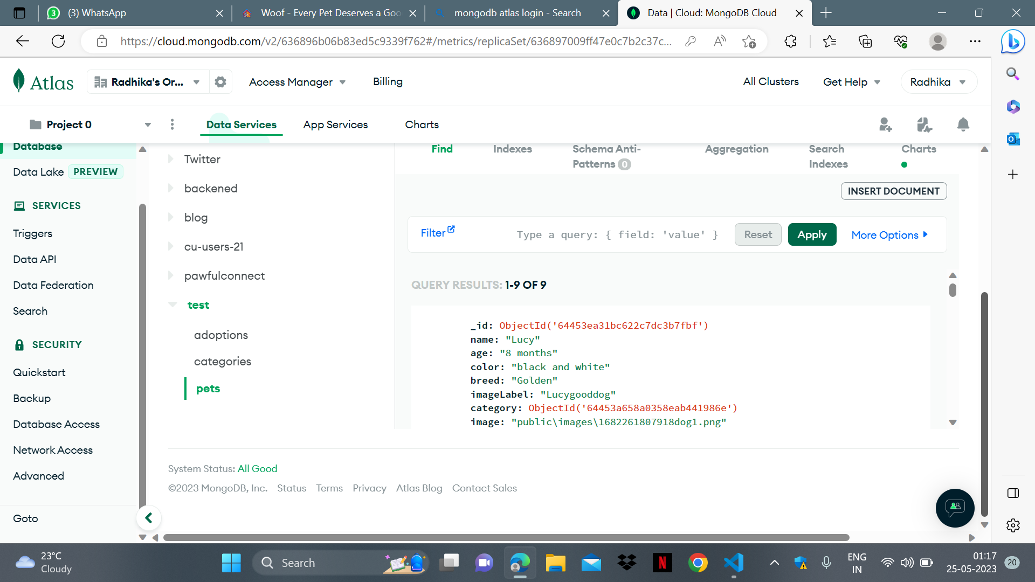

Slide 17
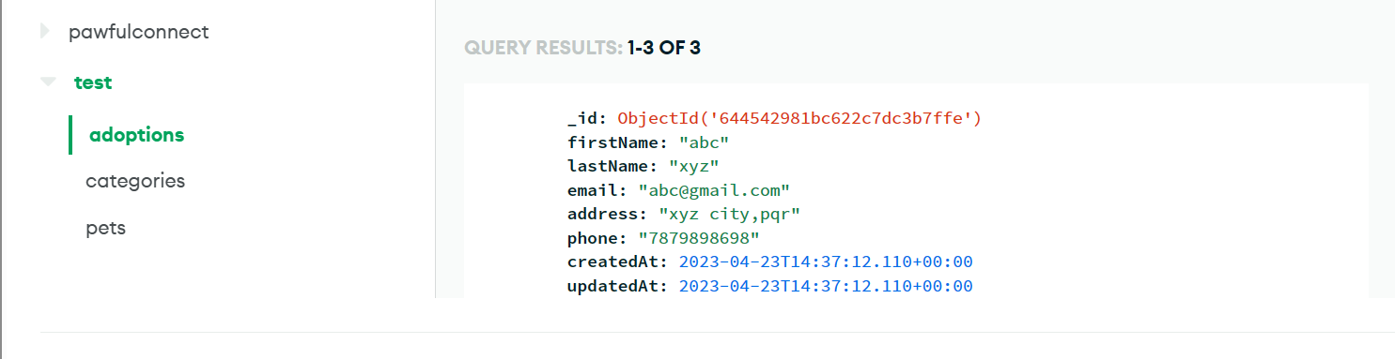
Continued…
Adoption Applications: When a visitor submits an adoption application through our website, the application data can be stored in a MongoDB collection. This makes it easy to manage and track adoption applications, as well as to retrieve and analyze the data as needed.

Slide 18
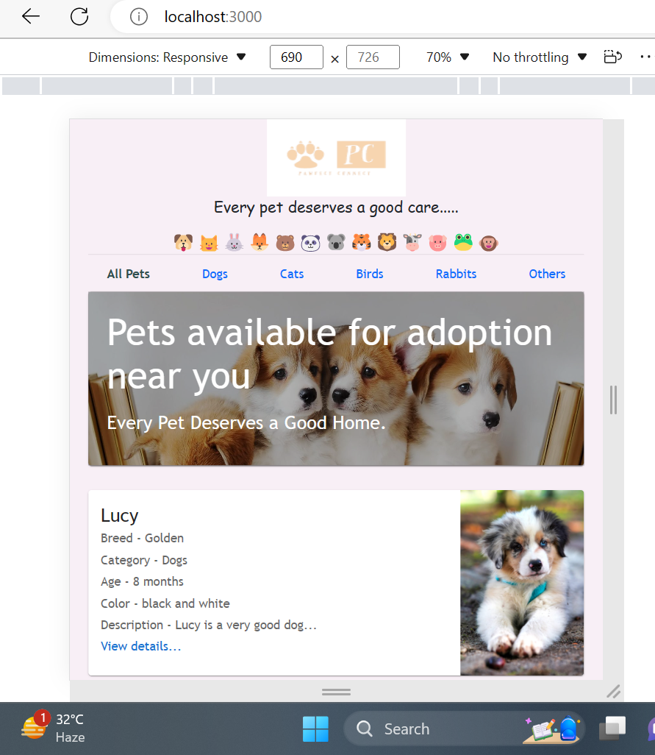
Responsiveness of the website
Responsiveness of a website refers to how well it adapts to different screen sizes and devices. In other words, a responsive website is one that can be viewed easily on any device, including desktop computers, laptops, tablets, and smartphones, without any loss of functionality or content.
To make a website responsive, web designers use a combination of techniques such as flexible layouts, responsive images, and media queries. By designing with responsiveness in mind from the beginning, web designers can create websites that are adaptable to any device or screen size, and provide a seamless user experience across all platforms.

Slide 19
How we made our site Responsive?
Planned the layout: We sketched out a rough layout of our website, taking into account the different screen sizes and devices that our visitors would use to access the site. We considered how the website would look on small screens, such as smartphones, and how the layout would change as the screen size increased.
Designed for mobile first: We designed the website with a mobile-first approach, meaning we focused on designing the website for the smallest screen size first, and then scaled up to larger screens. This ensured that our website looked good on smaller screens and was functional on all devices.

Slide 20
Continued…
Used a responsive design framework: We chose a responsive design framework, such as Bootstrap, that provided a responsive grid system and pre-designed components that could be customized to fit our website's needs.
Tested the website: We tested the website on different devices and screen sizes to ensure that it was responsive and displayed correctly. We made any necessary adjustments to the layout and design to ensure that the website was user-friendly on all devices.

Slide 21
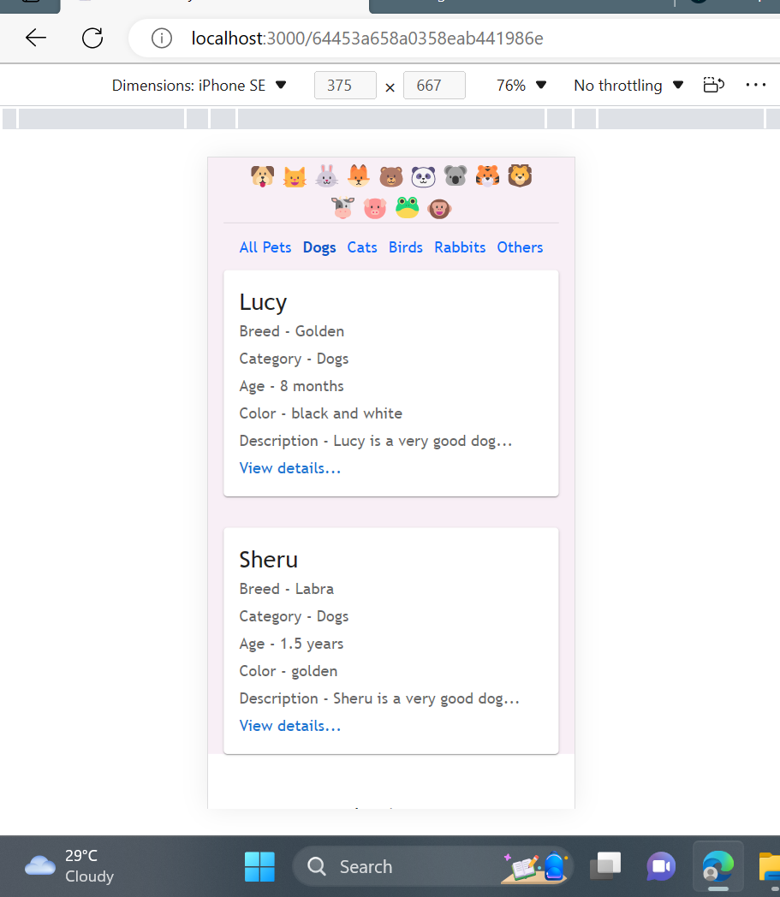

Slide 22
About Form which we created in our website
This form was used for adopting new pets or fostering animals. It was intended for individuals who wanted to provide a loving home to a pet in need. Hence, it is a validated form.
Applicants were required to provide personal information including their Name, Mobile Number, Email Address, House address.

Slide 23
Continued…
The form asked for the applicant's intentions for the pet, such as whether they wanted to adopt or foster and for how long.
After submitting the form, applicants were contacted for an interview to assess their suitability as a pet owner or foster caregiver.
The form was an important step in ensuring that pets were placed in safe and caring environments where they could thrive.

Slide 24
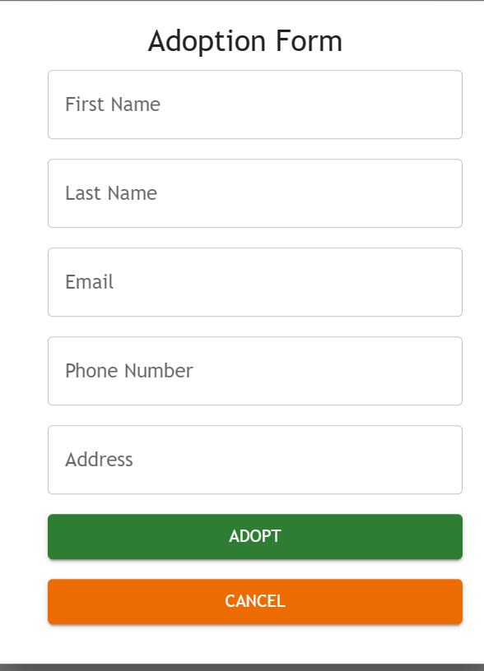

Slide 25
Data that we added
We had a feature on our animal help care website that provided data about all the animals available for adoption, fostering, or aid.
The data was collected through database and manual entry, which ensured that it was comprehensive and up-to-date.
Our animal data feature made it easier for people to find and provide aid to animals in need.

Slide 26
Continued..
We manually entered detailed information about each animal, such as their breed, age, temperament, medical history, and any special needs.
This data allowed potential adopters and foster caregivers to better understand each animal's personality and needs before making a decision.

Slide 27
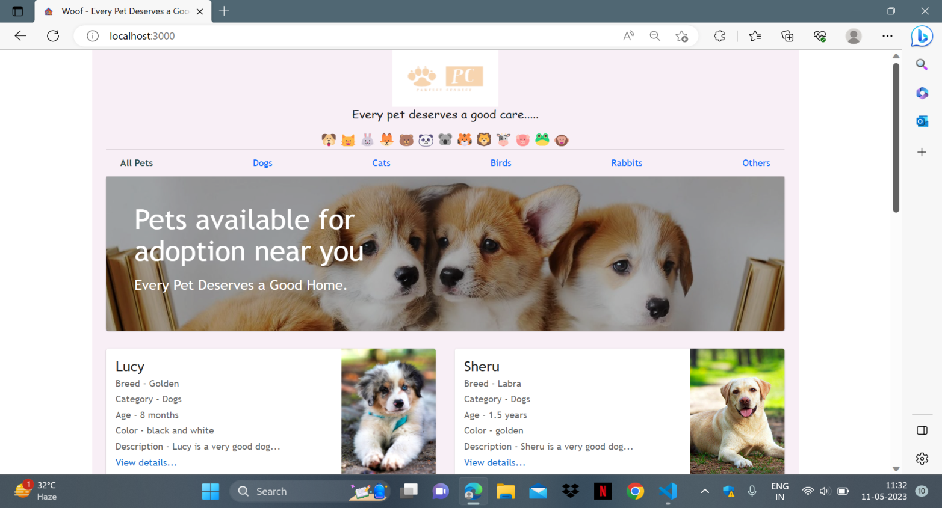
Overall view of our Project
Our heartfelt mission is to provide aid and find forever homes for these vulnerable creatures, offering them the love and care they deserve. With a deep passion for animal welfare, we have created a platform that connects compassionate individuals like you with the opportunity to make a lasting impact.

Slide 28
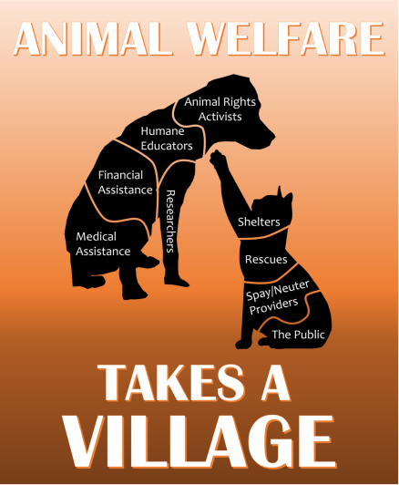
Key learning from the project
Expertise in database management, front-end development, and back-end development for the web.
Understanding of the concepts of software engineering, including system design, implementation and deployment.
Knowledge of the development lifecycle, which includes requirements gathering, design, implementation, and testing, as well as project management skills, which includes planning, scheduling, and risk
management.
Knowledge of communication tools, issue tracking software, and version control systems.
Understanding the significance of user experience and user-centered design in software
development.

Slide 29
Future Scope
Pawfect Connect, an animal helpcare centre has the potential for significant future growth and expansion. With a strong foundation and a focus on user experience and animal welfare, there are several avenues for further development and enhancement of the project. Here are some potential areas of future scope for the project:
Enhanced User Features: To improve user engagement and satisfaction, additional features can be added to the project. For example, a messaging system can be implemented to facilitate communication between users interested in adopting animals and the animal shelters. Users can also be allowed to create personalized profiles, save favorite animals, and receive notifications for new animals matching their preferences. These enhancements will further enrich the user experience and increase user interaction on the platform.
Multi-language and Internationalization Support: To cater to a wider audience, introducing multi-language support can make it accessible to users from different regions and cultures. Localization features such as language preferences, currency conversions, and cultural considerations can help create a more inclusive and global platform.

Slide 30
Data Analytics and Insights: Implementing data analytics tools can provide valuable insights into user behavior, popular animal preferences, and adoption trends. These insights can assist animal shelters and welfare organizations in making data-driven decisions, optimizing resource allocation, and tailoring their services to better serve the needs of animals and potential adopters.
By focusing on these areas of future scope, this website can continue to grow and evolve as a leading platform for animal helpcare and adoption. These enhancements will not only improve the user experience but also contribute to the well-being and betterment of animals in need. With ongoing development and updates, this project can become a powerful tool in promoting animal welfare and connecting animals with loving homes worldwide.

Slide 31
Thank You….!

